Slide 1

Auto Genie: Your Personal AutoML Assistant
By [Your Name/Company Name]

Slide 2
The Challenge: Navigating Machine Learning Complexity
Expertise Gap
Time-Consuming Workflow
Resource Intensive
Non-experts struggle with the technical hurdles of ML, from data preprocessing to algorithm selection.
Setting up robust ML pipelines requires significant computational resources and specialized software knowledge.
Even seasoned data scientists spend valuable time on repetitive tasks like exploratory data analysis and hyperparameter tuning.

Slide 3
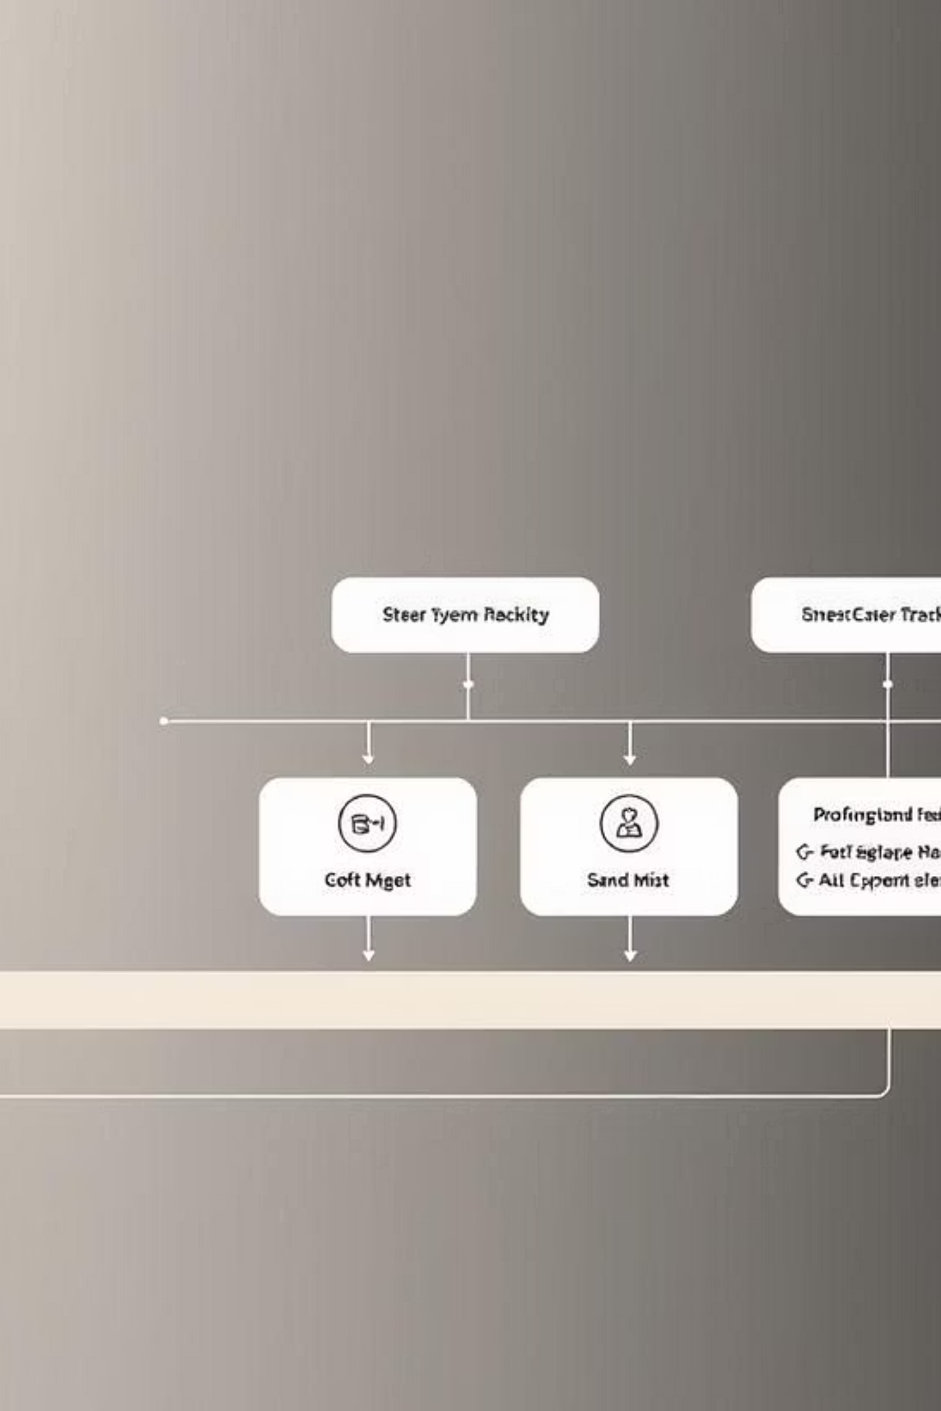
Auto Genie: Simplifying the ML Pipeline
Auto Genie is an intuitive, automated machine learning model trainer designed to democratize AI. It streamlines the entire ML workflow, making advanced analytics accessible to everyone.

Slide 4





Core Capabilities
Data Handling
Automated EDA
Model Selection
Effortless dataset upload with built-in validation to ensure data integrity.
Automatic exploratory data analysis provides instant insights into your dataset, identifying patterns and anomalies.
Intelligent suggestions for classification and regression models based on your data characteristics.
Auto-Training & Evaluation
Model Export
Seamless comparison of models and one-click export for immediate deployment.
Automated model training and comprehensive evaluation metrics for optimal performance.

Slide 5



Who Benefits from Auto Genie?
Startups & Businesses
Rapid ML prototyping and deployment for quick insights.
Empowers business analysts with limited ML background.
Educators & Students
Interactive platform for learning and experimenting with ML workflows.
Practical application of theoretical concepts without coding overhead.
Data Scientists
Saves significant time on routine and repetitive ML tasks.
Frees up resources for complex problem-solving and innovation.

Slide 6





How Auto Genie Works
1. Upload Dataset
Securely upload your CSV or Excel files. Auto Genie validates the data for optimal processing.
2. Exploratory Data Analysis
Receive automated insights, visualizations, and statistical summaries of your data.
3. Model Selection
Choose between classification or regression, and let Auto Genie suggest relevant models.
4. Training & Evaluation
Automated training across multiple algorithms, with comprehensive performance metrics.
5. Export Model
Download your trained model in a ready-to-use format for seamless integration.

Slide 7

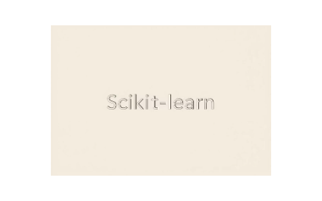

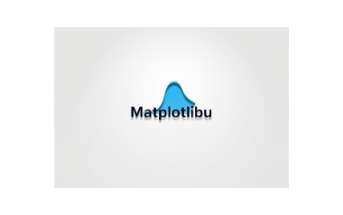


Robust Technology Stack
Auto Genie is built on a foundation of industry-standard, high-performance libraries and frameworks, ensuring reliability and scalability.

Slide 8

Leveraging IBM watsonx.ai
Our development process was significantly enhanced by IBM watsonx.ai, which provided a powerful environment for:
Experimentation & Benchmarking: Rapidly test and compare different AutoML pipelines and models.
Understanding AutoML: Gaining deeper insights into the mechanisms and best practices of automated machine learning.
Model Interpretability: Utilizing its tools to understand model decisions and enhance transparency.

Slide 9

Auto Genie: In Action
Experience the intuitive design of Auto Genie, from data ingestion to insightful visualizations.
Compare model performance side-by-side and select the best fit for your needs.

Slide 10


The Future of Auto Genie
Deep Learning Integration
Cloud Deployment
Advanced Monitoring & APIs
Offering cloud-native solutions for scalable, secure, and accessible model training.
Expanding capabilities to include support for complex deep learning architectures.
Seamless integration with model monitoring tools and robust APIs for custom workflows and user management.
Ready to Transform Your ML Workflow?

